Slide 1
To replace with my own drawing

Slide 2
CSS143 Computer Programming (II)

Slide 3
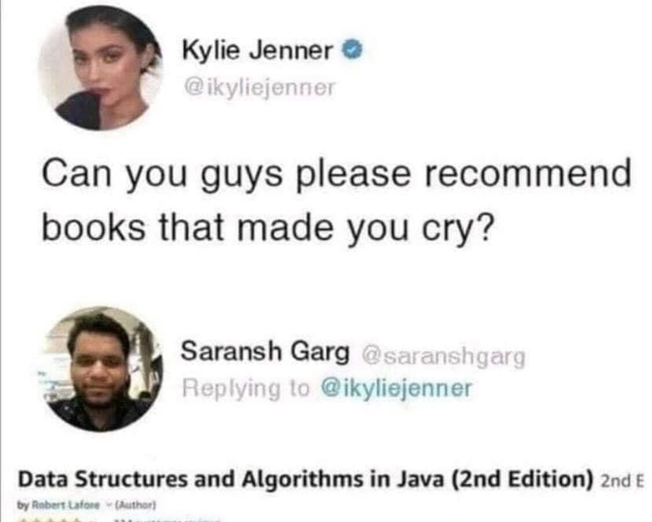

Slide 4

Agenda
Monday
Reviews
Quiz 1
Wednesday
Recursion

Slide 5

Learn to Learn
Manage Class Materials
Textbook
Slides
Lecture Code
20%
30%
50%
Manage Your Time
Reading
Coding
Discussion
20%
60%
20%

Slide 6
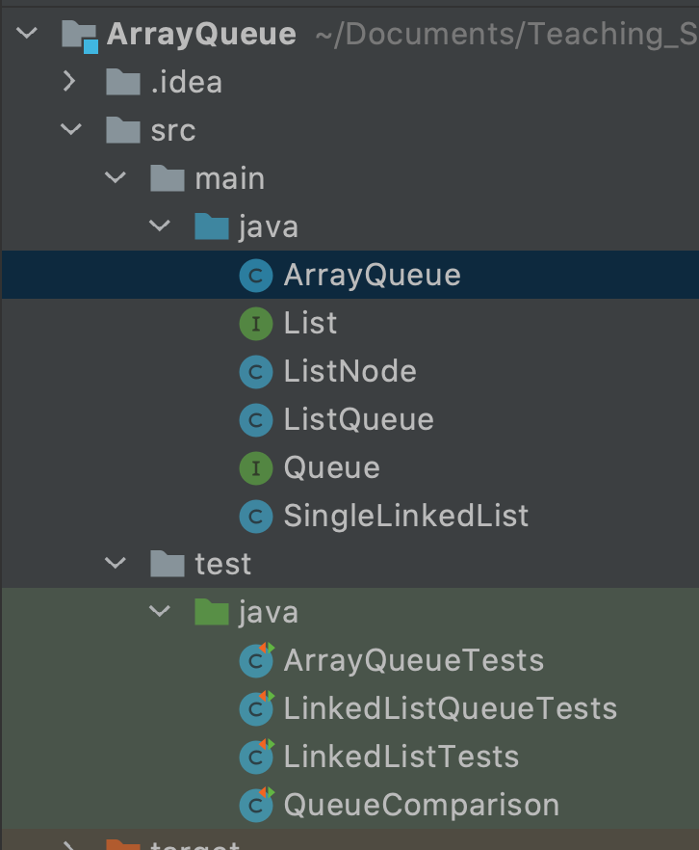
How to use lecture code example
1. To understand concepts
2. Exercise for homework

Slide 7
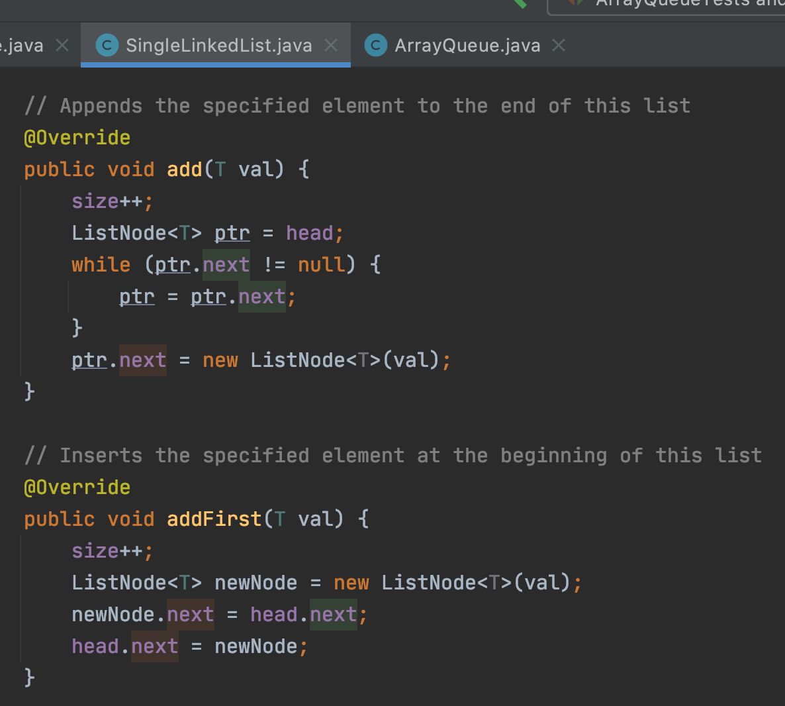
How to use lecture code example
1. To understand concepts

Slide 8
How to use lecture code example
2. To help homework
“Where do I start?”

Slide 9
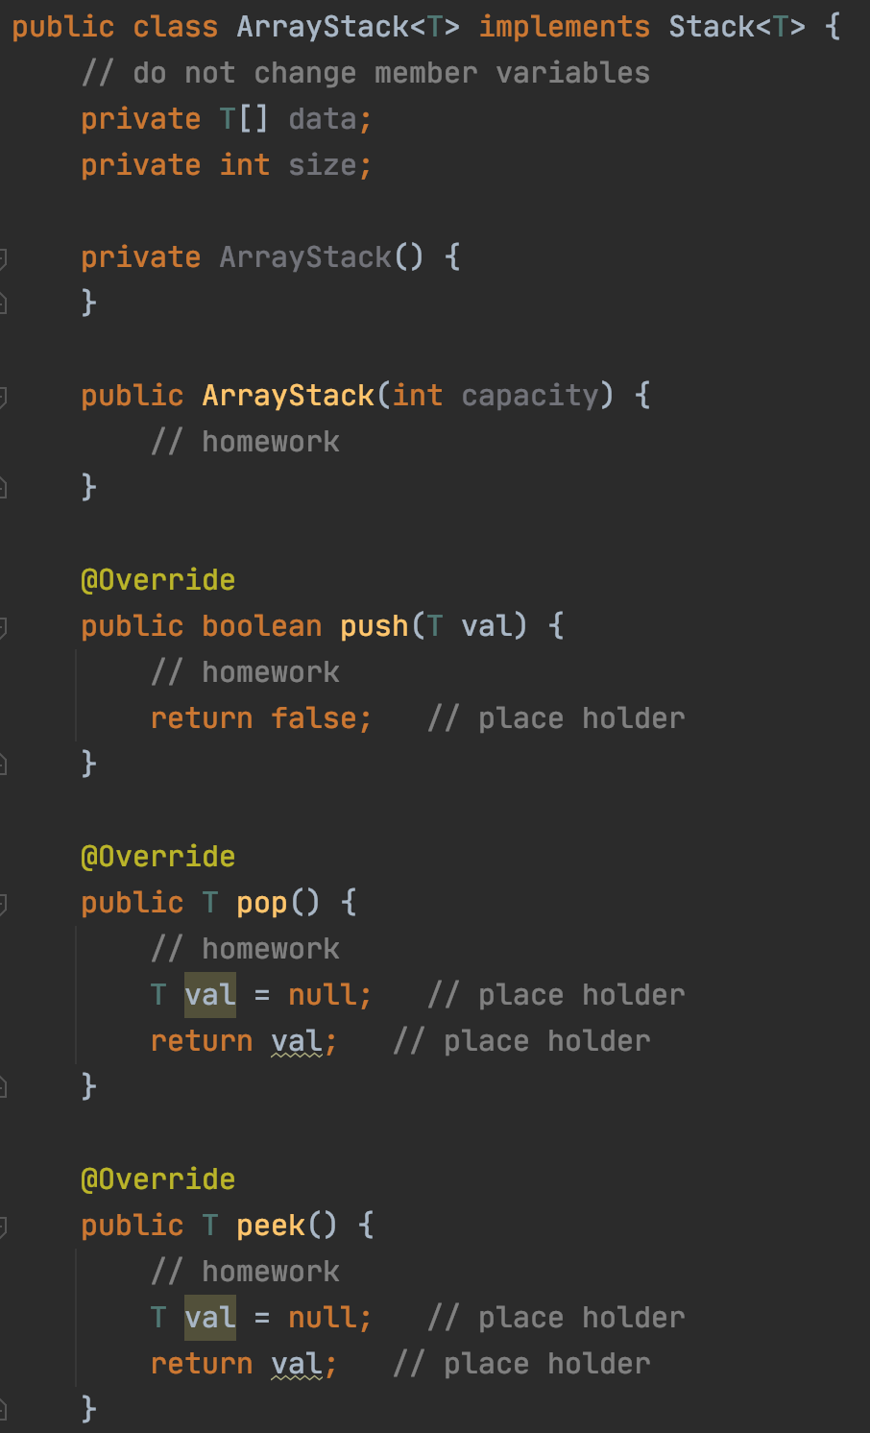
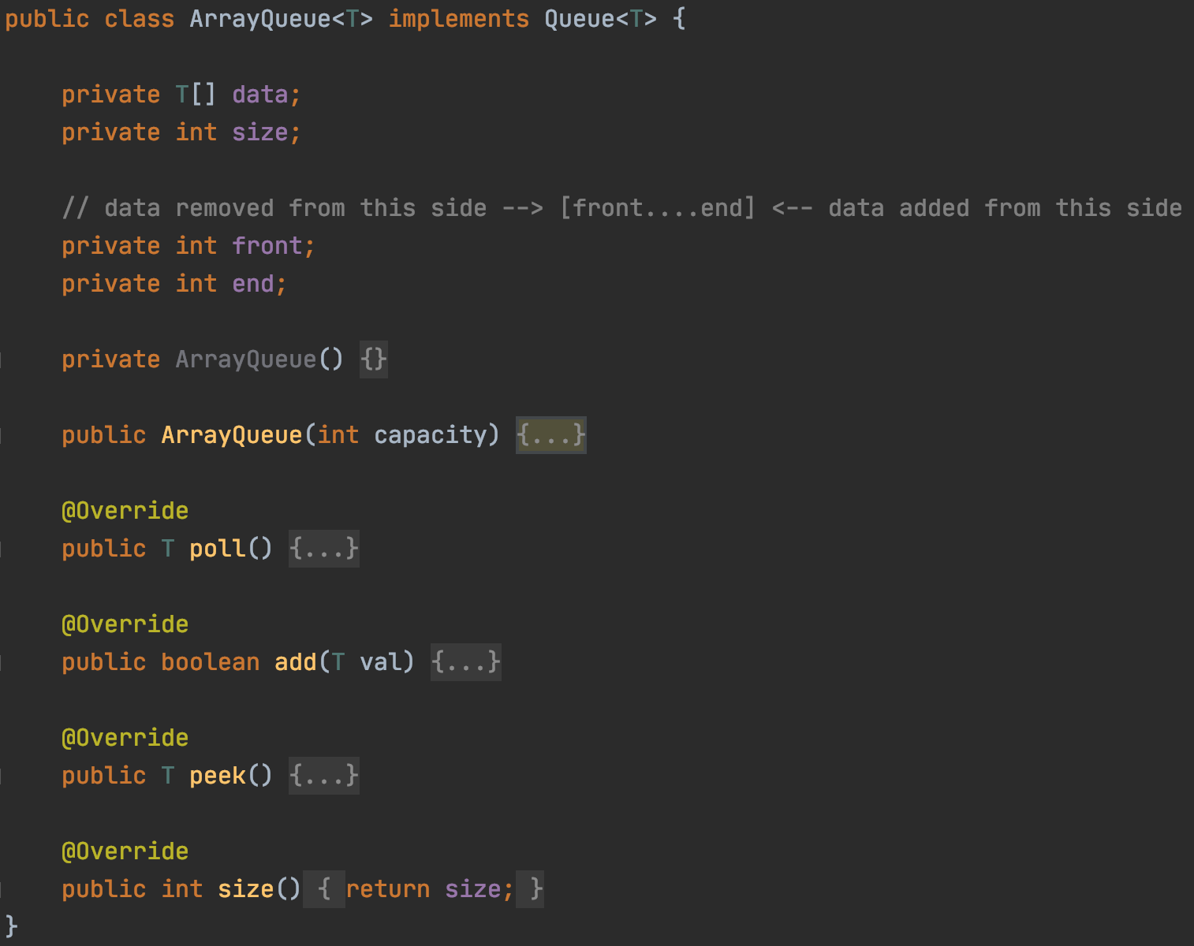
How to use lecture code example
2. Exercise for homework

Slide 10
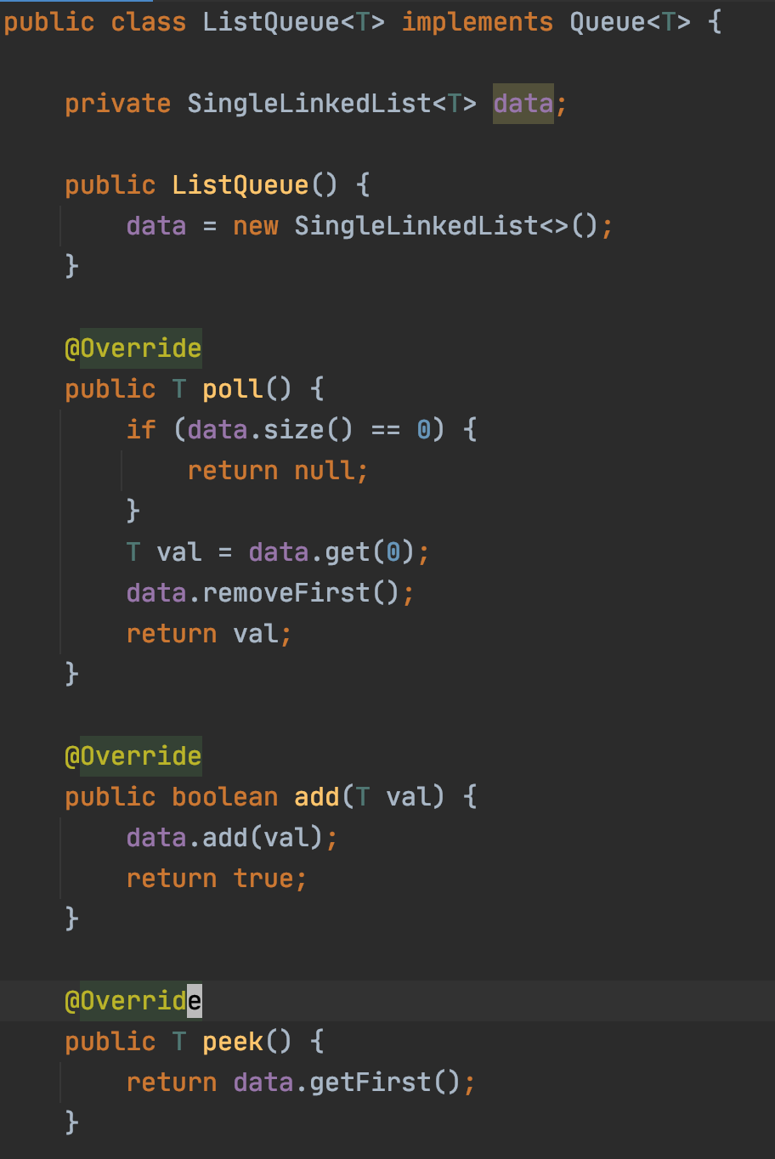
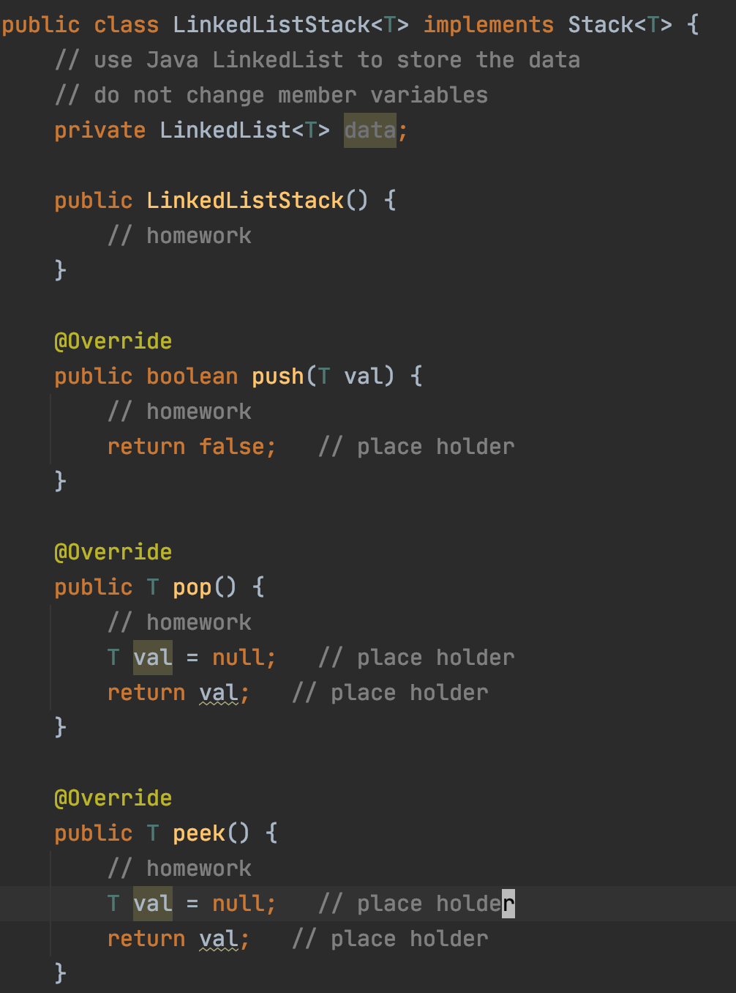
How to use lecture code example
2. Exercise for homework

Slide 11
Parkinson’s Law
“Work complicates to fill the available time.”
Given 4 days, I’ll start work on day 3
Given 7 days, I’ll start work on day 6
Given 10 days, I’ll start work on day 9

Slide 12
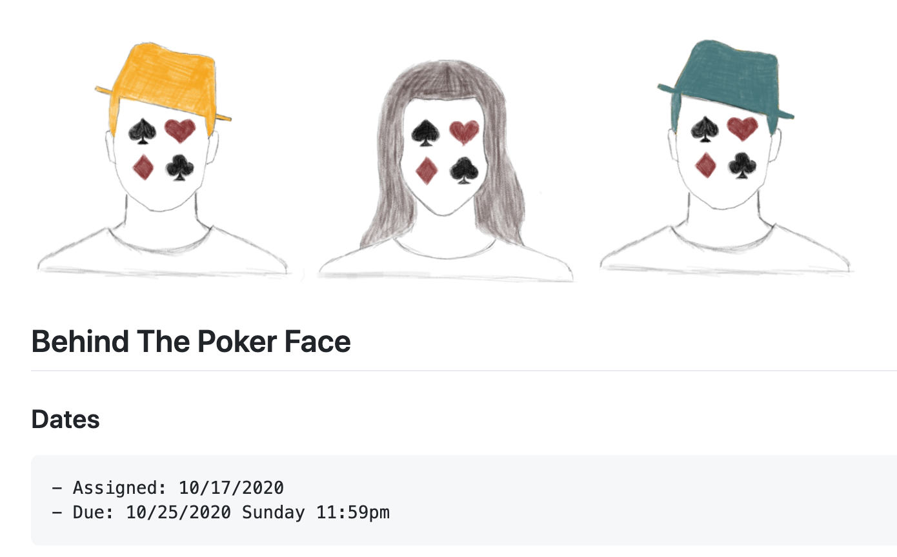
Parkinson’s Law
Given 8 days,
how many days did you give yourself for homework 3?
A. 1 day
B. 2 day
C. 4 day
D. 5+ day

Slide 13
Homework 2 Review

Slide 14
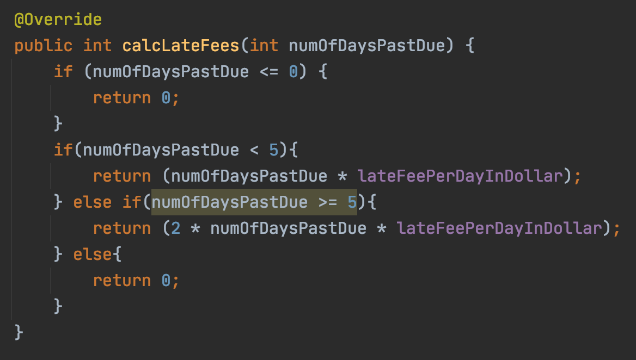
How many problems do you see?

Slide 15
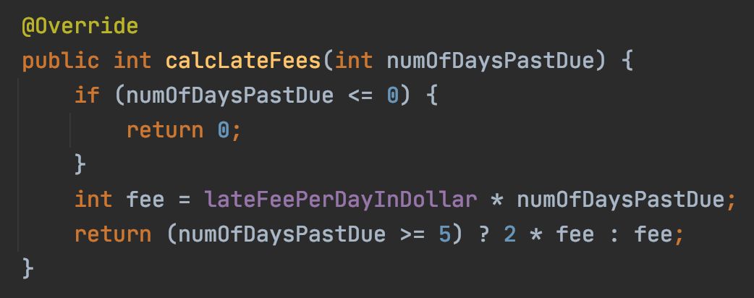
How many problems do you see?

Slide 16
Homework 3 Review

Slide 17
Quiz 1

Slide 18
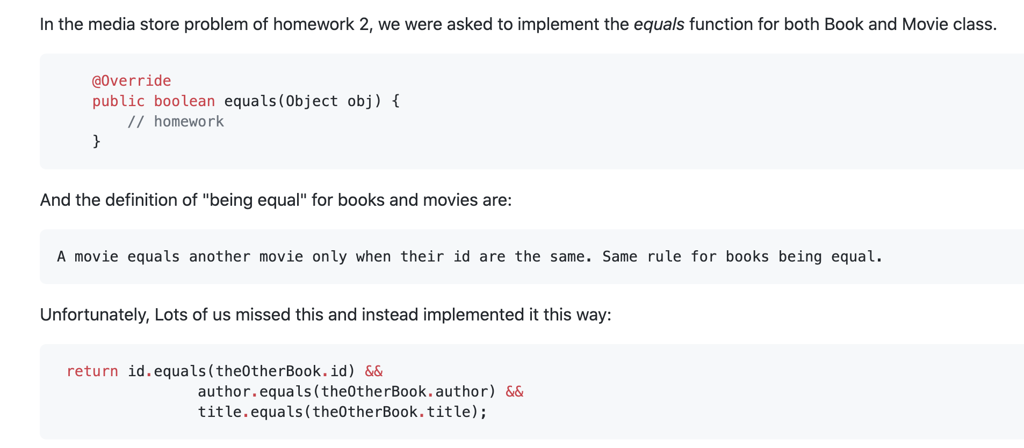

Slide 19
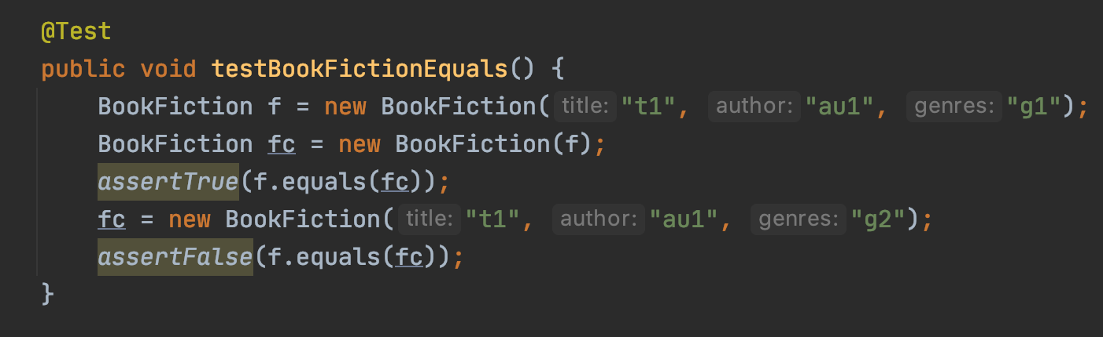
Why does the tests pass when there’s bug?

Slide 20


What do you do when a bug is found and to be fixed?
Fix the bug in the function
2. Fix the bug in the function and add a test for it
3. Add a test first, see it fails,
then fix the bug in the function,
and see the test pass

Slide 21
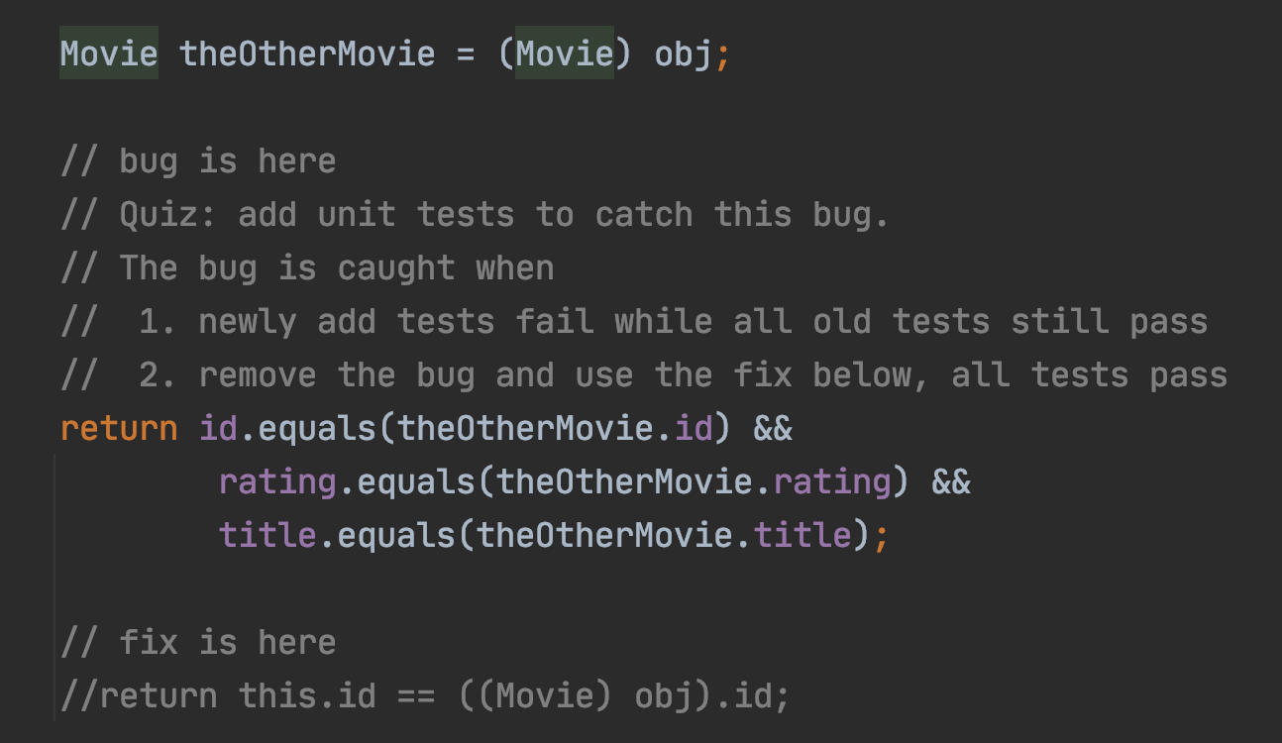

Slide 22
Add more tests
Add new tests to show the bug
Old tests still pass
New tests fail
Fix the bug
Validate bug fixed
Old tests still pass
New tests pass

